Slide 1

Interoperability Thomas Künneth
https://unsplash.com/photos/m0l9NBCivuk

Slide 2
Questions 🤔

Slide 3
Inter... what...?
Combining (mixing) Jetpack Compose and traditional Views
by using Compose in XML based layouts
by using a View in a Compose hierarchy
Why would I want that? 🤔

Slide 4
Getting to know Compose takes some time, so better start small
Big bang migrations just don’t work

Slide 5
A required View may not be available as a composable
The app uses a View-based third-party library
Preserve investments by keeping self-developed or acquired custom components (for a while)
Fragments and activities rely om Views

Slide 6
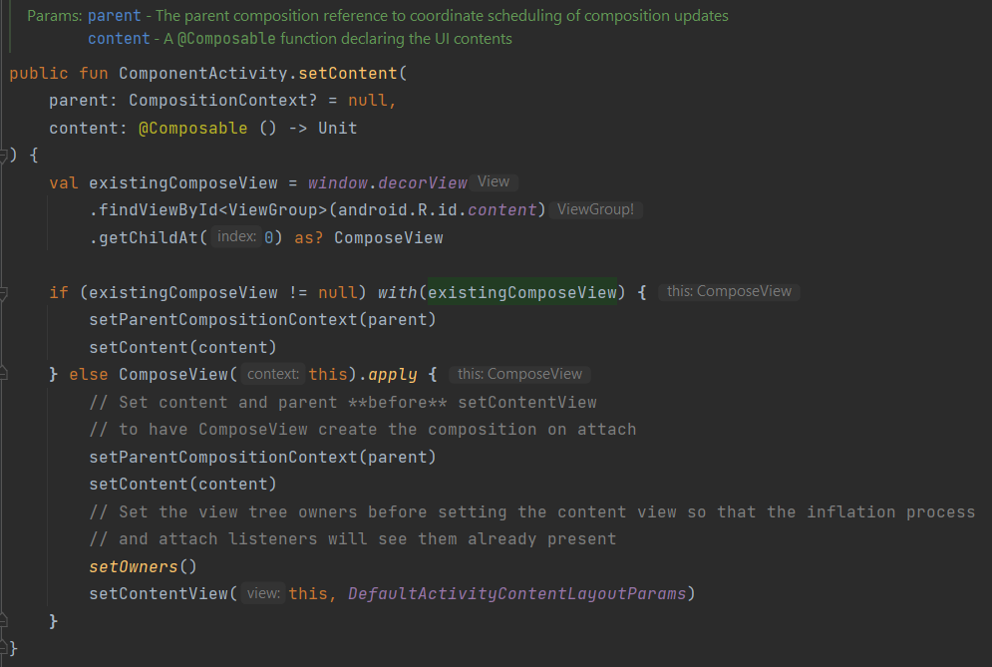

Slide 7

ComposeView hosts a Compose hierarchy
AndroidViewBinding() and AndroidView() host View hierarchies
https://unsplash.com/photos/vYgjtzcoEDY

Slide 8
To include a Compose hierarchy...
Use ComposeView in the layout file
Configure the ComposeView
Implement the composable

Slide 9
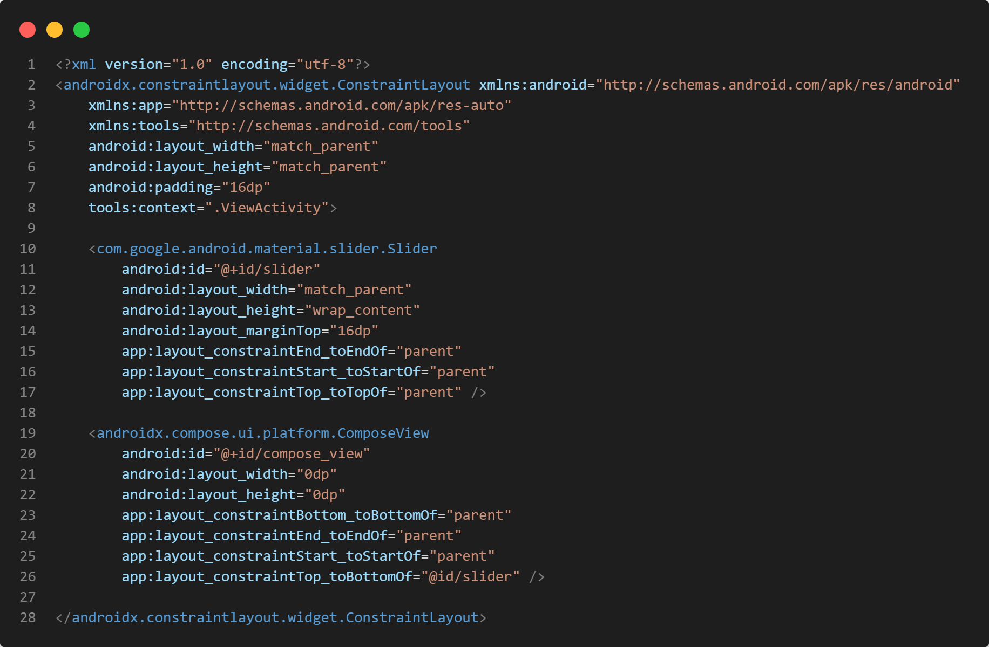
A parent layout
Some children
Render a Compose hierarchy

Slide 10
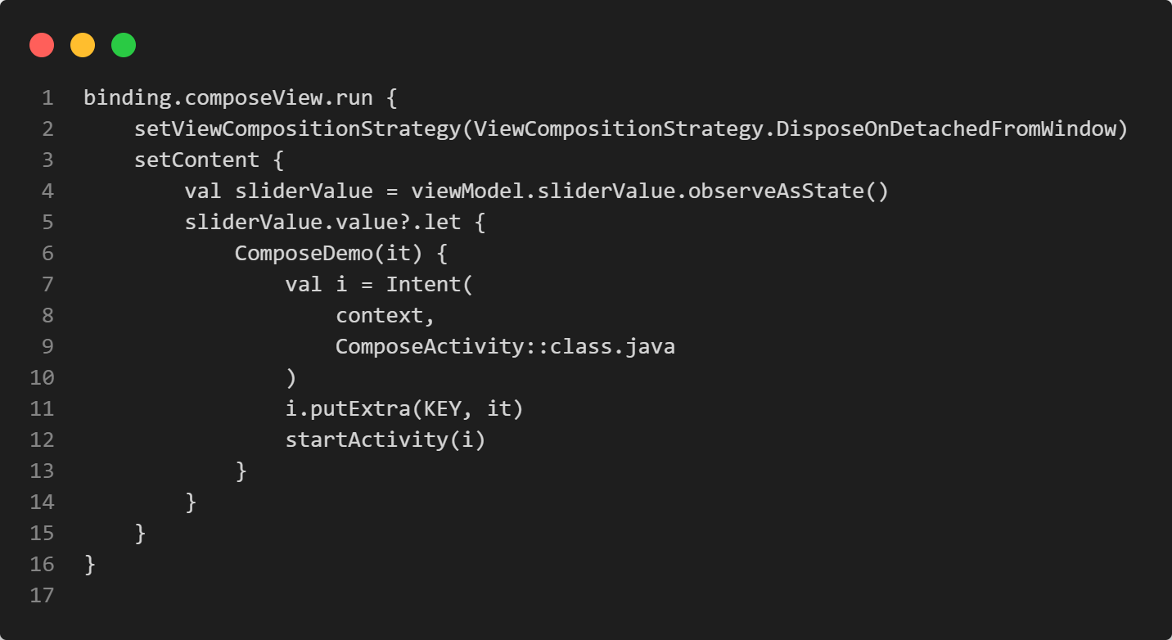
We are using View Binding
When to dispose the Compose hierarchy
We use a ViewModel ... for what...?
Invoke the root composable

Slide 11
ViewModels contain data and logic needed by Views
Have been an established pattern on Android for many years
Used on other platforms before they became mainstream on Android

Slide 12
Greatly ease synchronization of Views and composable functions
Should be used in any Android app anyway, because they
help structure and unclutter the code
help sharing data among activities and fragments
have their own independent lifecycle

Slide 13
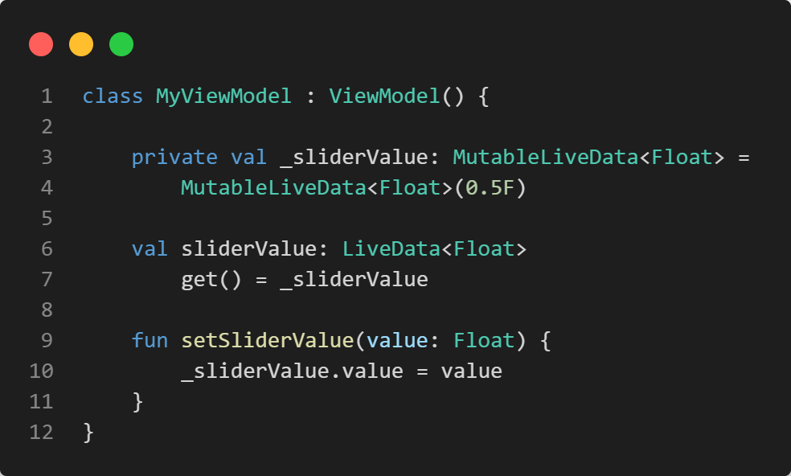
Usually extend androidx.lifecycle.ViewModel
Store (changeable) observable data
Allow observation of such data
Provide means to change data

Slide 14
Implementation of observable pattern (LiveData, Kotlin Flows, ...) can be chosen based on requirements
If an app already uses ViewModels the current implementation should be re-used to avoid changes to View-based code
The conversion to Compose state depends on the chosen implementation

Slide 15
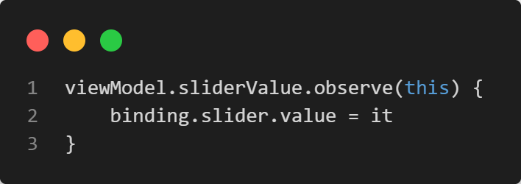
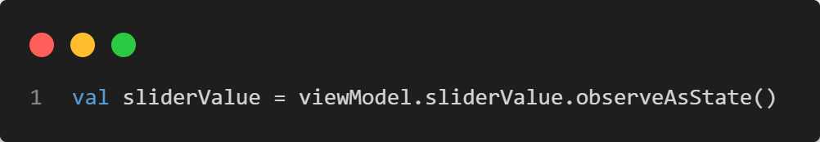
Observing a ViewModel property
for views
for composables

Slide 16
To include a View hierarchy...
Inflate the View hierarchy
Define the logic for changes
Embed in a Compose hierarchy

Slide 17
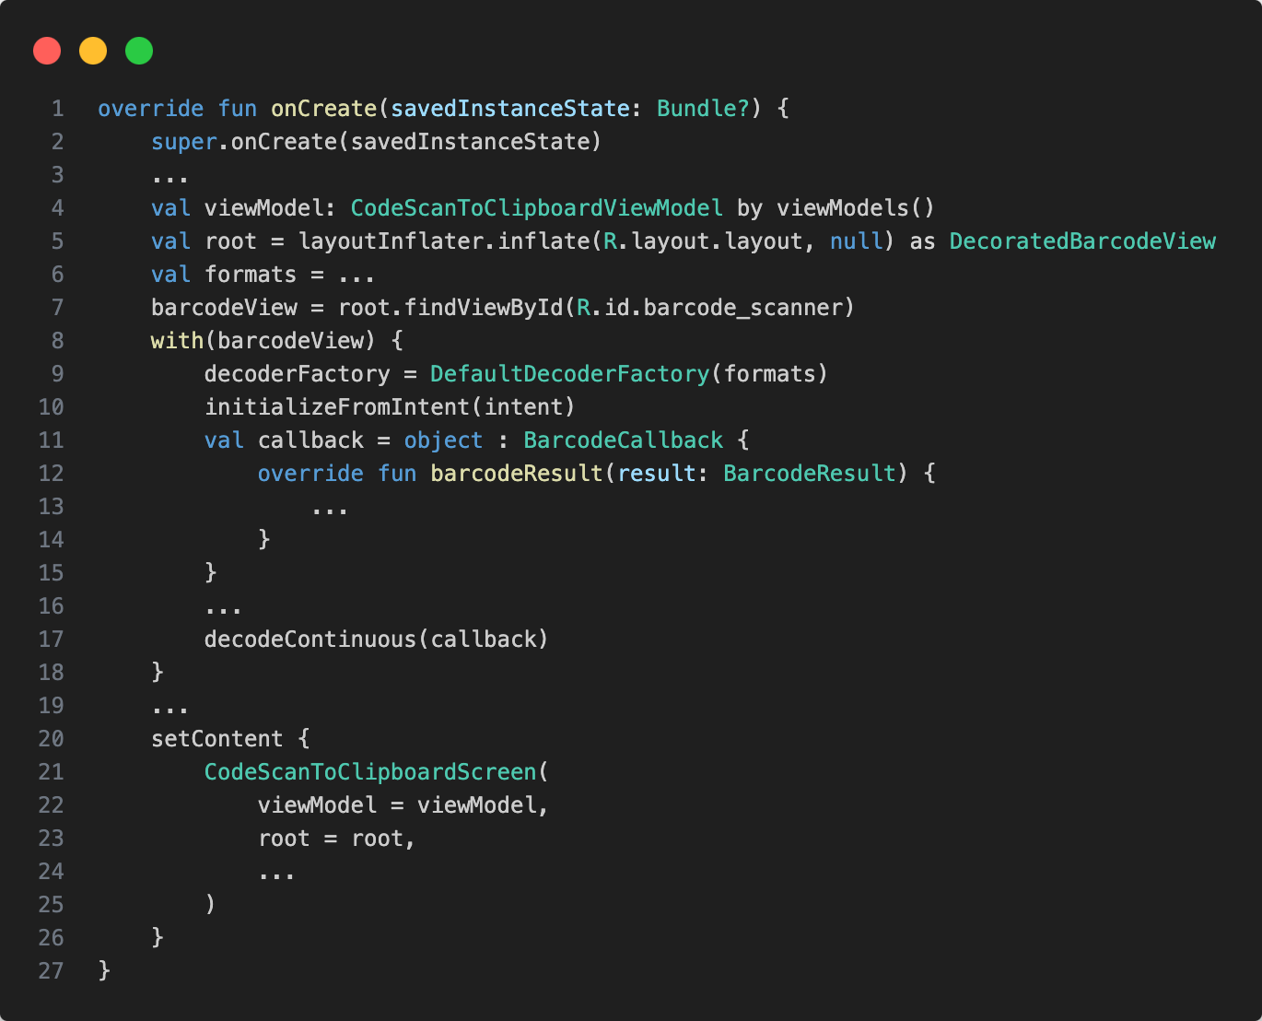

Slide 18
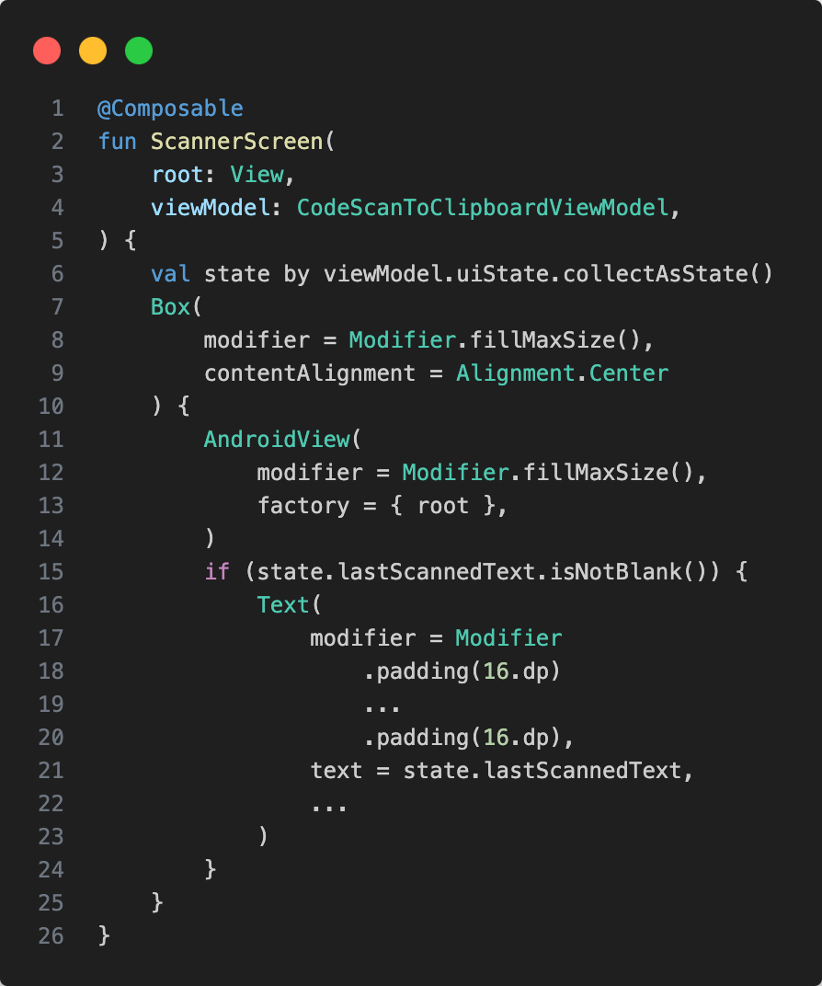

Slide 19
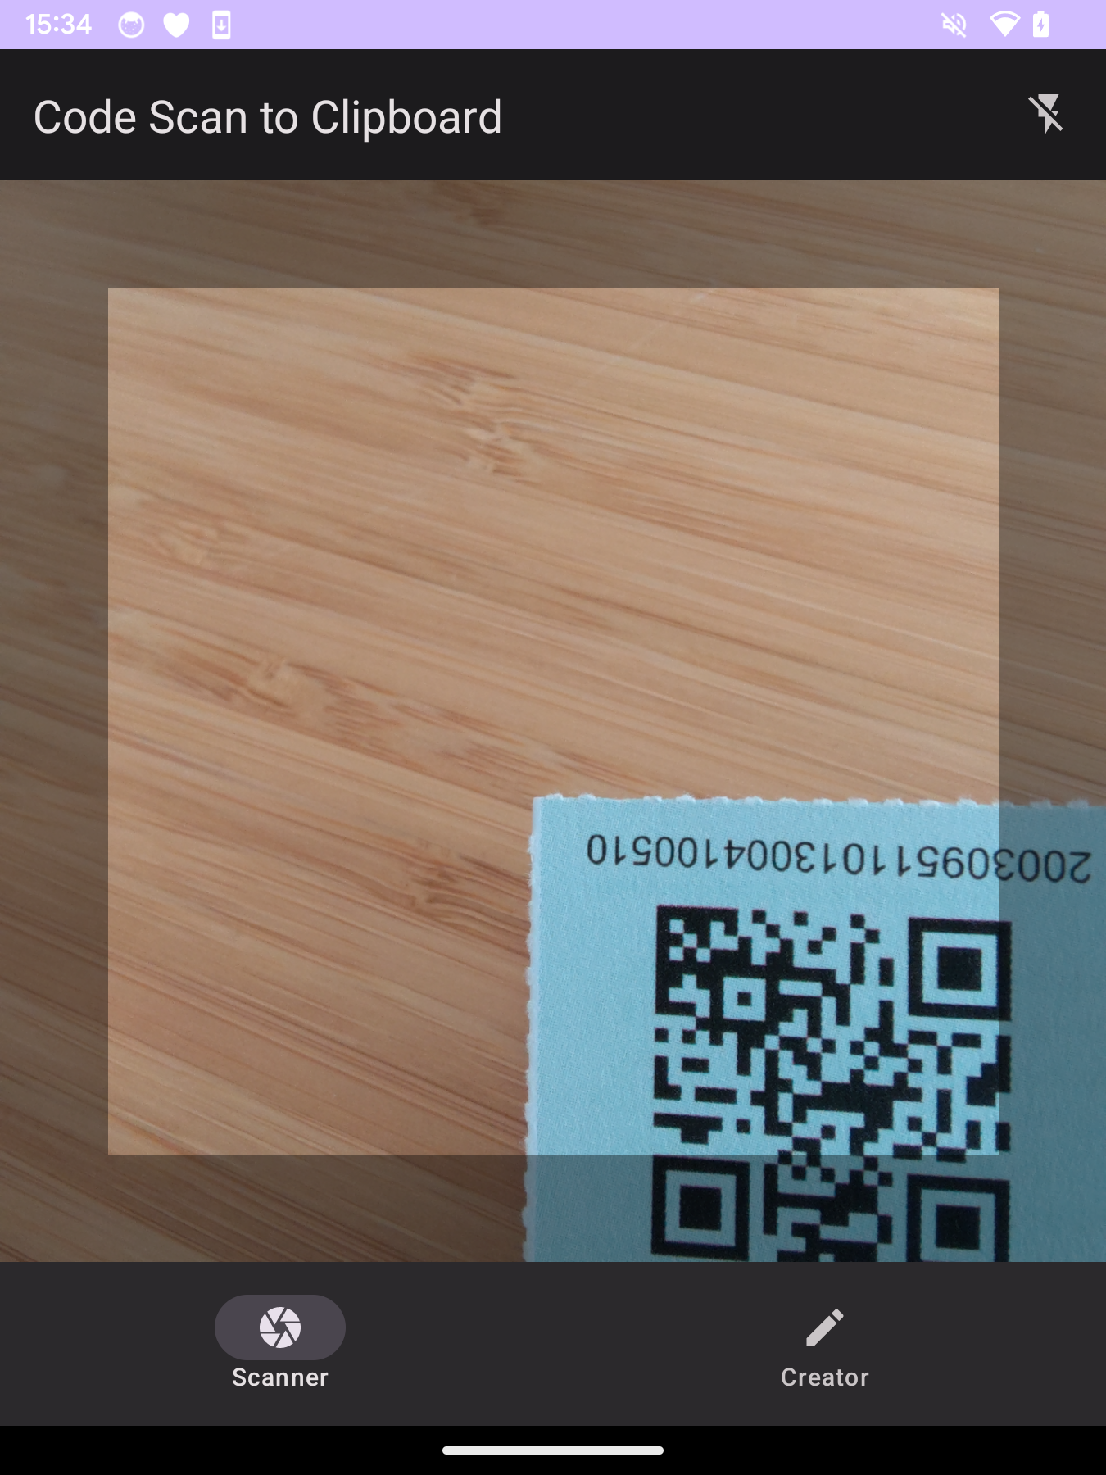
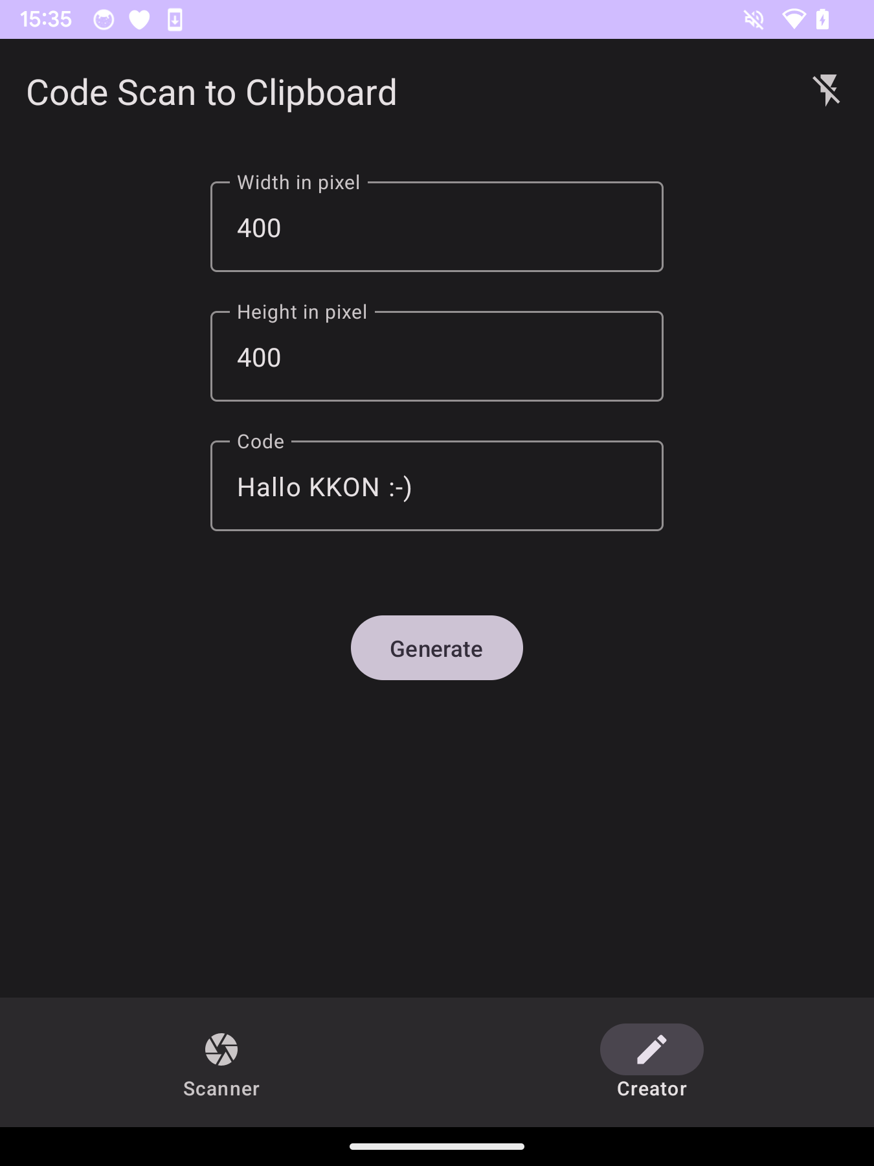
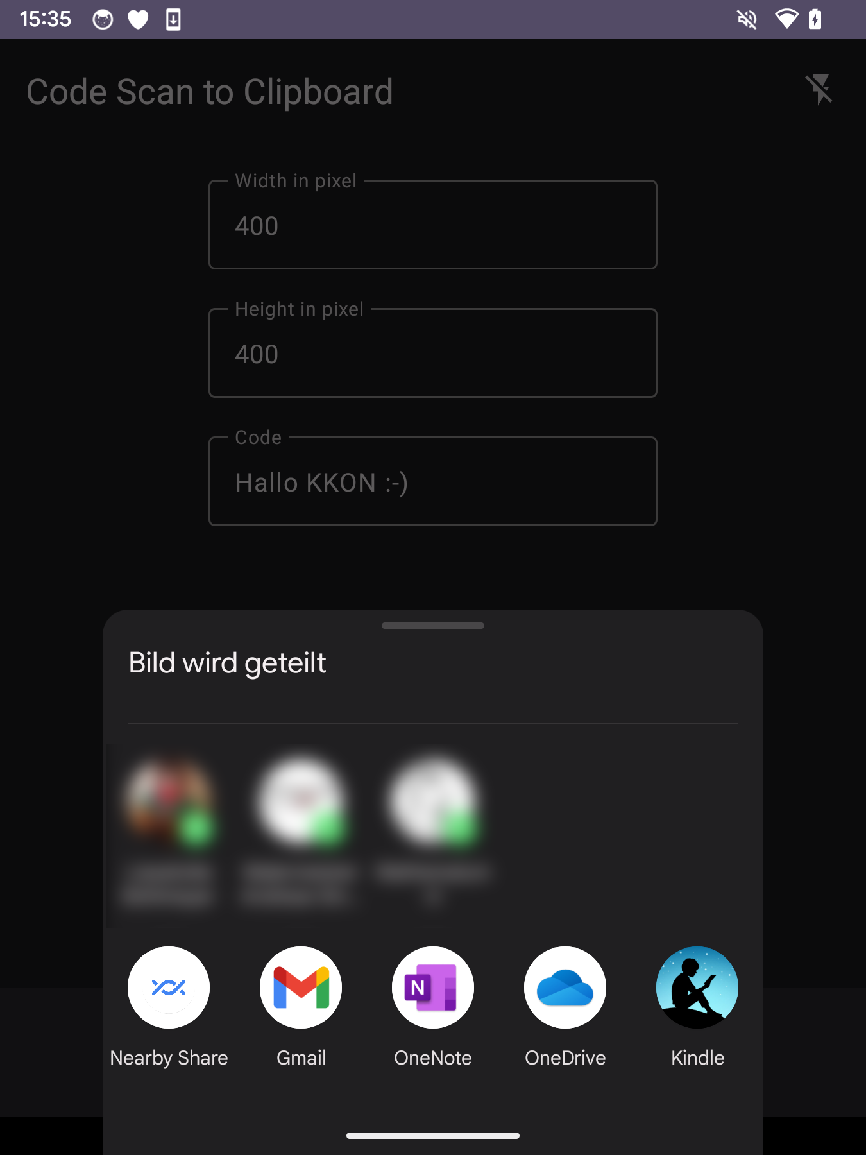
https://github.com/tkuenneth/CodeScanToClipboard

Slide 20

Short break… 😍

